Slide 1
Data-Intensive Systems
Bachelor project proposals 2022
Cigdem Aslay, Ira Assent, Panagiotis Karras, Davide Mottin

Slide 2
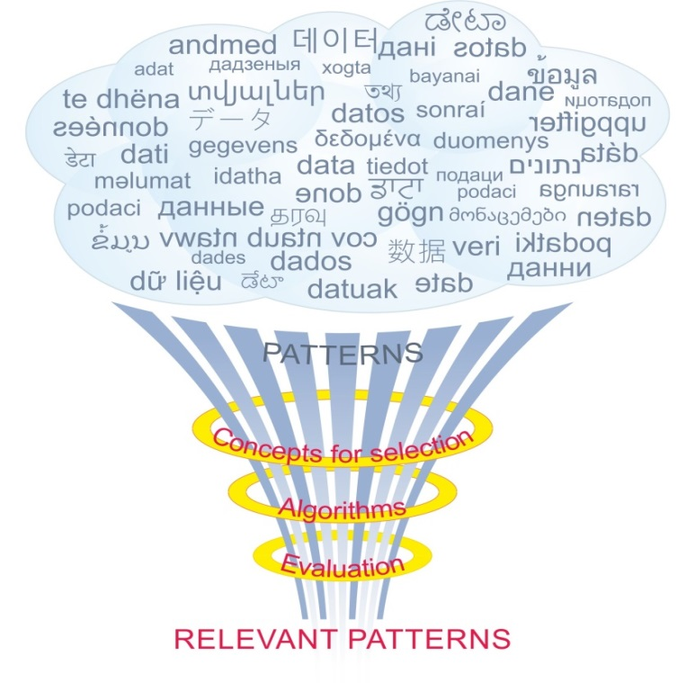
Our research group
Our interests
Data management, data analysis, machine learning
Efficiency and scalability
Models and algorithms
Our methods
Formalize real world problems
Devise concepts and algorithmic solutions
Evaluate empirically
Our tools and results
Theoretical analysis and prototype implementations
Query results and analysis

Slide 3
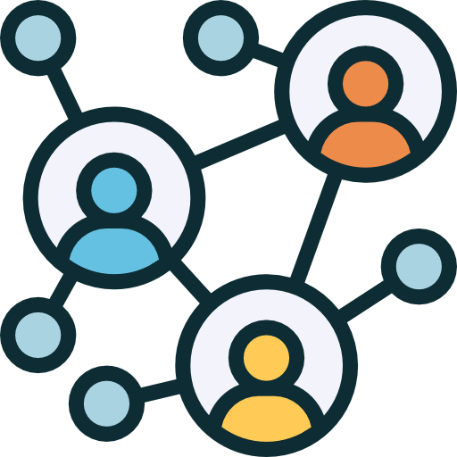

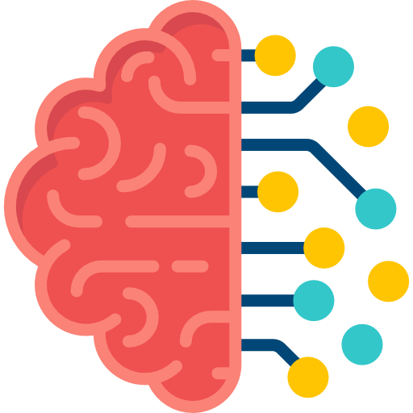
Projects in a Nutshell
Approximating Betweennes Centrality on Large Graphs
Efficient and Scalable Influence Maximization in Online Social Networks
Studying the fairness of ML models
Creating and Personalizing Large Knowledge Graphs
Evolutionary games and spatial upstream reciprocity
ReliK: Reliable Knowledge Graph Embeddings
SAGA: Scalable Algorithms for Graph Alignment
Structural social balance under controversy
BeCom: Benchmark for community detection
Similarity Search with Dynamic Time Warping
Graph analysis
Interaction Models
AI aspects

Slide 4
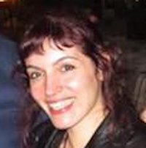

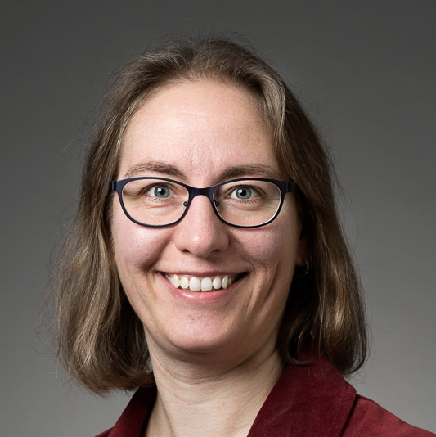
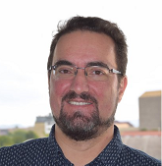
Graph analysis
How can we fast detect ”broker” people in a social network?
Algorithms for Approximating Betweenness Centrality on Large Graphs
How can we easily evaluate whether two users belong to the same community?
BeCom: Benchmark for community detection
How do we create and maintain high-quality knowledge graphs for medical doctors?
Creating and Personalizing Large Knowledge Graphs
SAGA: Scalable Algorithms for Graph Alignment
Can we find the same users in two very large social networks?

Slide 5
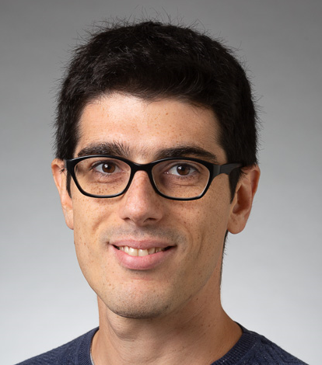
Interaction models
How do I compute fast the set of most influencial users in a social network?
Efficient and Scalable Influence Maximization in Online Social Networks
Why do we spend time, effort, and resources in cooperating with others?
Evolutionary games and spatial upstream reciprocity
Structural social balance under controversy
Can there be stability if controversial arguments are discussed?
Similarity Search with Dynamic Time Warping
How can we efficiently search time series under complex distance models?

Slide 6
AI aspects
Is a ML algorithm fair? Can a machine be fair? Are there good models for fairness?
Studying the fairness of ML models
ReliK: Reliable Knowledge Graph Embeddings
Is there any way I can be sure that my learned representation of a graph is actually correct?

Slide 7
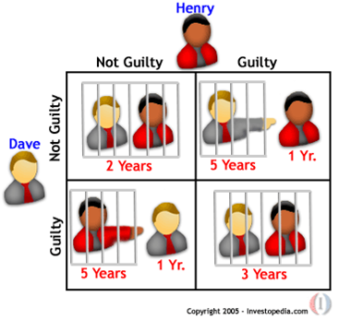
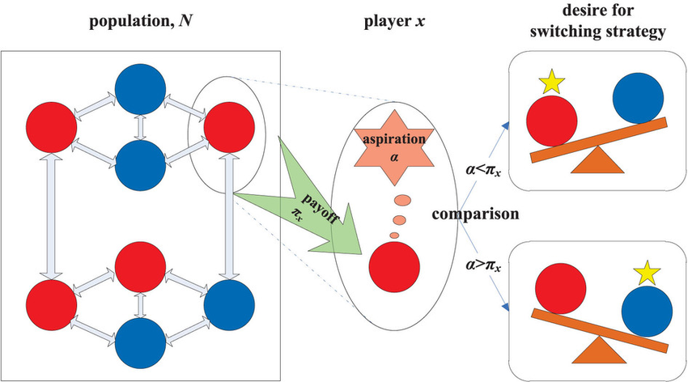
Structural Balance on Social Networks
“The friend of my enemy is my enemy”
Implement and study the stochastic process
How long until balance is reached?
How does the distribution of friendships look at the end?
Which graphs promote cooperation?
“The enemy of my enemy is my friend”
Evolution of Cooperation on Graphs

